Slide 1
Scalable Data Processing : By applying MapReduce in Spark
#Big-data #MapReduce #ML
Dayoung Kang
Jaehyeon Kim
Subin Seo

Slide 2
Background Research
What is Big-data ?
: Any data set contains large volumes of information and complex data is called Big Data (BD). It has 4 characteristics. (4V’s) ^{[1]}
Volume which is the quantity of data.
Velocity is the speed of the data that during handling and generating.
Variety refers to the range of data types and sources.
Veracity is related to the truth of data which is important for precision in analysis.
+ Value is the importance of the data importance and this is a very significant feature in BD6.
BD is unlike traditional data, so it requires special processing to manage it.
Notes:
분산처리와 병렬처리
Scalable dig data
분산처리 => partitioning processing
병렬처리 => multiprocessing (python library )
Core가 많은 cpu에서 속도가 더 빠름. ( cpu가 많을수록 빠른 경우 병렬처리가 잘 이루어진 것을 테스트하기 위해 서버환경에 따른 결과를 비교함. )
Pyspark 환경에서 functional programming 으로 map reduce를 구현! [clustering 자동, RDD 데이터 구조 활용 ]
=> Final : Spark로 mapreduce를 구축하여, 성능 테스트 !

Slide 3
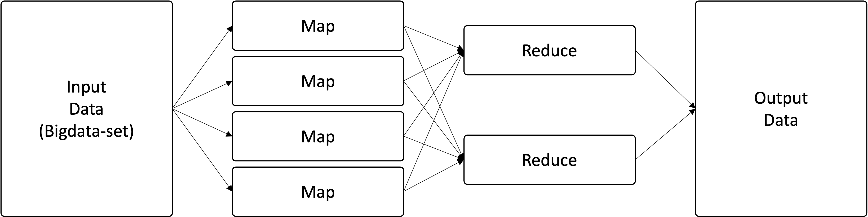
Background Research
How to process Big-data ?
: apply for MapReduce to process Big Data in parallel on multiple node.
Step1. Map
Split input data to number of slices
Apply specific function to each to generate intermediate results
Step2. Reduce
Combine the intermediate results to make the final result.

Slide 4
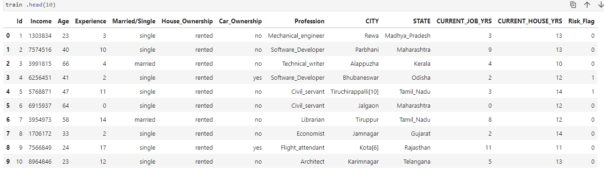
About Data
: Customer information to predict who possible Defaulters are for Loans Product
Independent variables ( X )
Dependent variables ( Y )
Train_Data_shape : (252000, 13 )
It has 252,000 samples and 11 features.
Independent variables are used to predict of Risk_Flag which is dependent variables.
Risk_Flag(Y) is binary clas ( 0 or 1 ) .

Slide 5


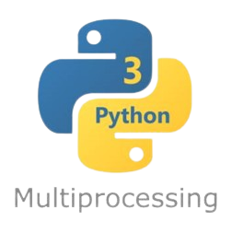

We try 2 way to Implement MapReduce !
Preview
VS

Slide 6
Using Python Muti processing library

Slide 7
Python
Modules for parallelism in Python: Multiprocessing
process
CPU
process
multiprocessing
process
process
Pool Object
which offers a convenient means of parallelizing the execution of a function across multiple input values, distributing the input data across processes (data parallelism).

Slide 8
Python
Multiprocessing: Pool Object
startmap( ) or map()
close( )
to stop further jobs
execute tasks in parallel
split data into multiple partitions
each partitions processing in parallel
join( )
to wait for all jobs complete

Slide 9
Python
Map
Goal: Binary Classification with Linear Regression
Calculate gradient by Ordinary Least Squares (OLS) for each partition
process
gradient
CPU
process
gradient
param gradient * learning rate
multiprocessing
process
gradient
process
gradient
MAP

Slide 10
Python
Reduce
Combines the intermediate results and updates the model parameters
Sum the gradients then multiplied by learning rate to return the updated parameters
process
gradient
CPU
process
gradient
param gradient * learning rate
multiprocessing
process
gradient
process
gradient
REDUCE

Slide 11
Python
MapReduce with multiprocessing
 | Pycharm(M1) | JupyterLab(DIONE)
Pool Worker(CPU cores) | 8 | 48
Processing TIme | 4min 2.028sec | 1min 3.902sec
Since multiprocessing performs parallel processing based on the number of cores in the CPU, we were able to get faster results on the DIONE server with 48 CPU cores.

Slide 12
Using Pyspark ( RDDs)

Slide 13
Spark
Apache Spark™ is a multi-language engine for executing data engineering,
data science, and machine learning on single-node machines or clusters.
Batch/streaming
data
SQL analytics
Data science
at scale
Machine learning

Slide 14
Spark
How does Spark do distributed and parallel processing?
Clustering
RDD & DAG

Slide 15

Spark
< Clustering >
Spark is capable of in-memory operation and distributed processing, which speeds up. ➨ Because, Cluster Manager allocates Worker nodes to CPUs on its own and performs distributed processing.

Slide 16
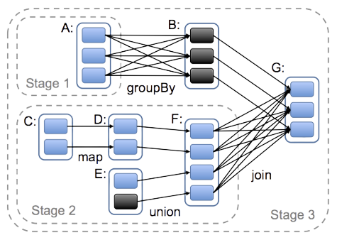
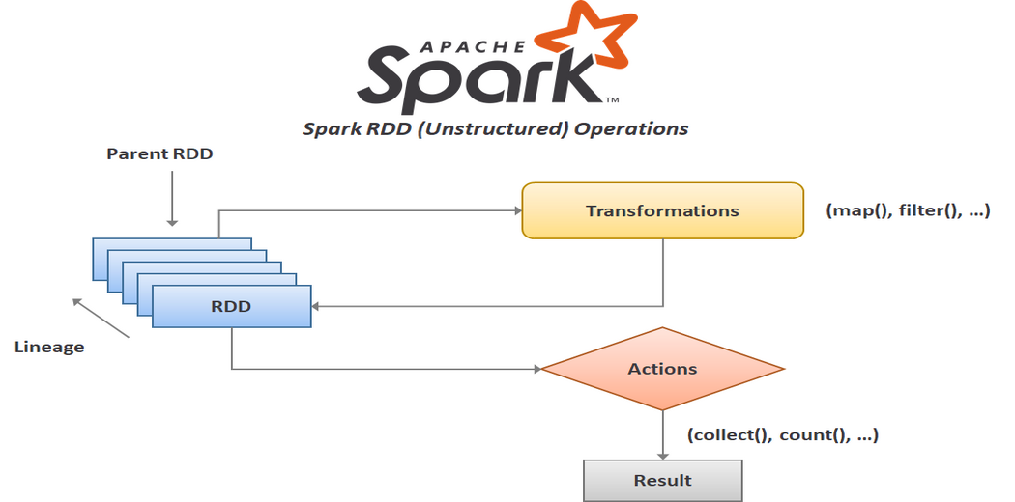
Spark RDD & DAG
< RDD >
< DAG>
RDD is Spark's fundamental data abstraction concept, which is a distributed collection of data elements divided into multiple partitions. ➨ Immutable & Read-only system!
DAG is a Directed Acyclic Graph that expresses dependencies between tasks. ➨ All transformation is recorded as a DAG.

Slide 17





Spark Process
Parallelize
Data
Result
Partitioning(), convertToRDD()
map(), reduce()
The data is split into multiple partitions (num_partitions = 4).
The map function calculates the gradients for each partition in parallel (worker = 8).
The reduce function combines the gradients and updates the model parameters using a learning rate.
This process is repeated for a certain number of iterations (num_iterations = 100).

Slide 18
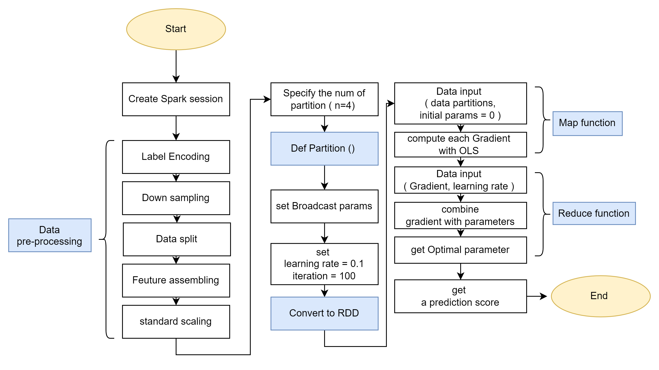
Flowchart

Slide 19
Current location
Notes:
Let's see in more detail

Slide 20
Data Pre-Processing
Label Encoding
Down Sampling
Data Split
Categorical data to number
Class0 - 221,004 samples
Class1 - 30,996 samples
Each class 30,996 samples
Total 61,992 samples
One Dataset file
Train 64%
Validation 16%
Test 20%
features
"married_single”
"profession”
"house_ownership”
"car_ownership”
"city”
"state”
Standard Scaling
Calibrate scale differences
Features ex.
Income(10,000,000)
Age(14)

Slide 21

Current location

Slide 22
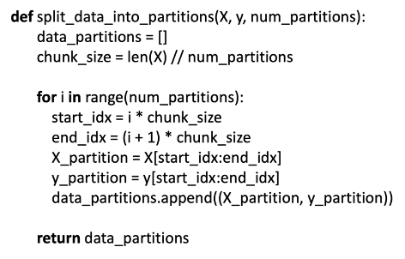
Function codes
Data Partitioning &
Covert to RDD
ark
ark
ark
Data
ark
ark
ark
ark
Data
Data
ark
Data
RDD
ark
Data
Rdd = spark.sparkContext.parallelize(data_partitions)
Notes:
We wanted to experiment as if we had distributed storage.

Slide 23
Current location

Slide 24
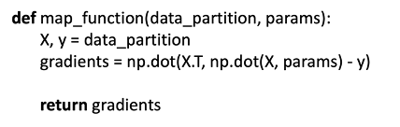
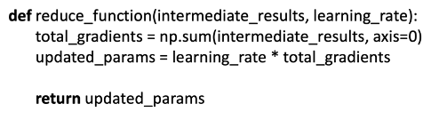
Function codes
MapReduce functional programming
Notes:
mapreduce runs in parallel

Slide 25
Current location

Slide 26
Spark Result
Spark
Elapsed Time | 0.0 min 41.307 sec
Val-ACC | 50.193
Test-ACC | 50.191
Scalable data can be distributed and processed in parallel through spark.
And this method is effective for processing big data.
Notes:
We did it in a single machine environment, but it would be much more efficient if we did clustering.

Slide 27
Discussion
In this project, Our data set can be storage and processed with in a local storage, which has about 60,000 samples.
=> Therefore, we are going to test the model of this paper with a lot bigger data sets. ( Use large amounts of data that are not even stored on the local storage)

Slide 28
Reference
[1] Hiba Basim Alwan and Ku Ruhana Ku-Mahamud 2020 IOP Conf. Ser.: Mater. Sci. Eng. 769 012007
[2] Matei Zaharia, Mosharaf Chowdhury, Michael J. Franklin, Scott Shenker, and Ion Stoica. 2010. Spark: cluster computing with working sets. In Proceedings of the 2nd USENIX conference on Hot topics in cloud computing (HotCloud'10). USENIX Association, USA, 10.
[3] Data Reference : https://www.kaggle.com/datasets/subhamjain/loan-prediction-based-on-customer-behavior?resource=download&select=Sample+Prediction+Dataset.csv
[4] Image Reference : https://subscription.packtpub.com/book/data/9781785889622/5/ch05lvl1sec39/linear-classification

